Slide 1
Engineering Lab
EN19003
Metallurgical and Materials Engineering (MME) department

Slide 2
General introduction to Metallurgical and Materials Engineering
Today’s specific lab experiment: Tensile behavior of different engineering Materials

Slide 3







Why Materials are IMPORTANT
Aviation
Structures
Energy storage
Biomaterials
Electronics
Aerospace
Automobiles
Application
of Materials

Slide 4
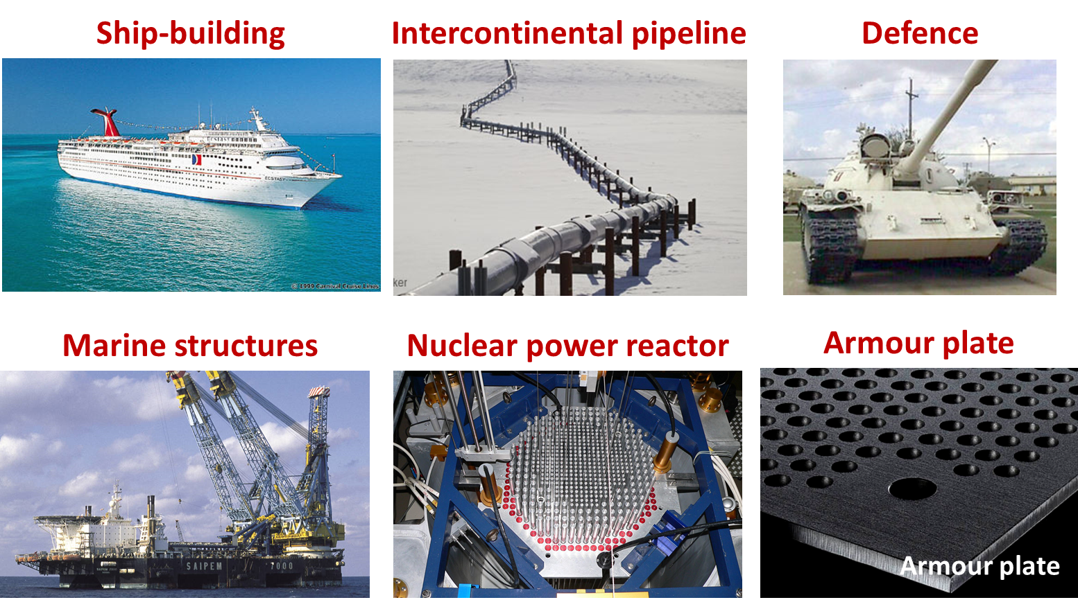
More niche applications of Materials
Metals/alloys are crucial in Metallurgy and Materials engineering

Slide 5
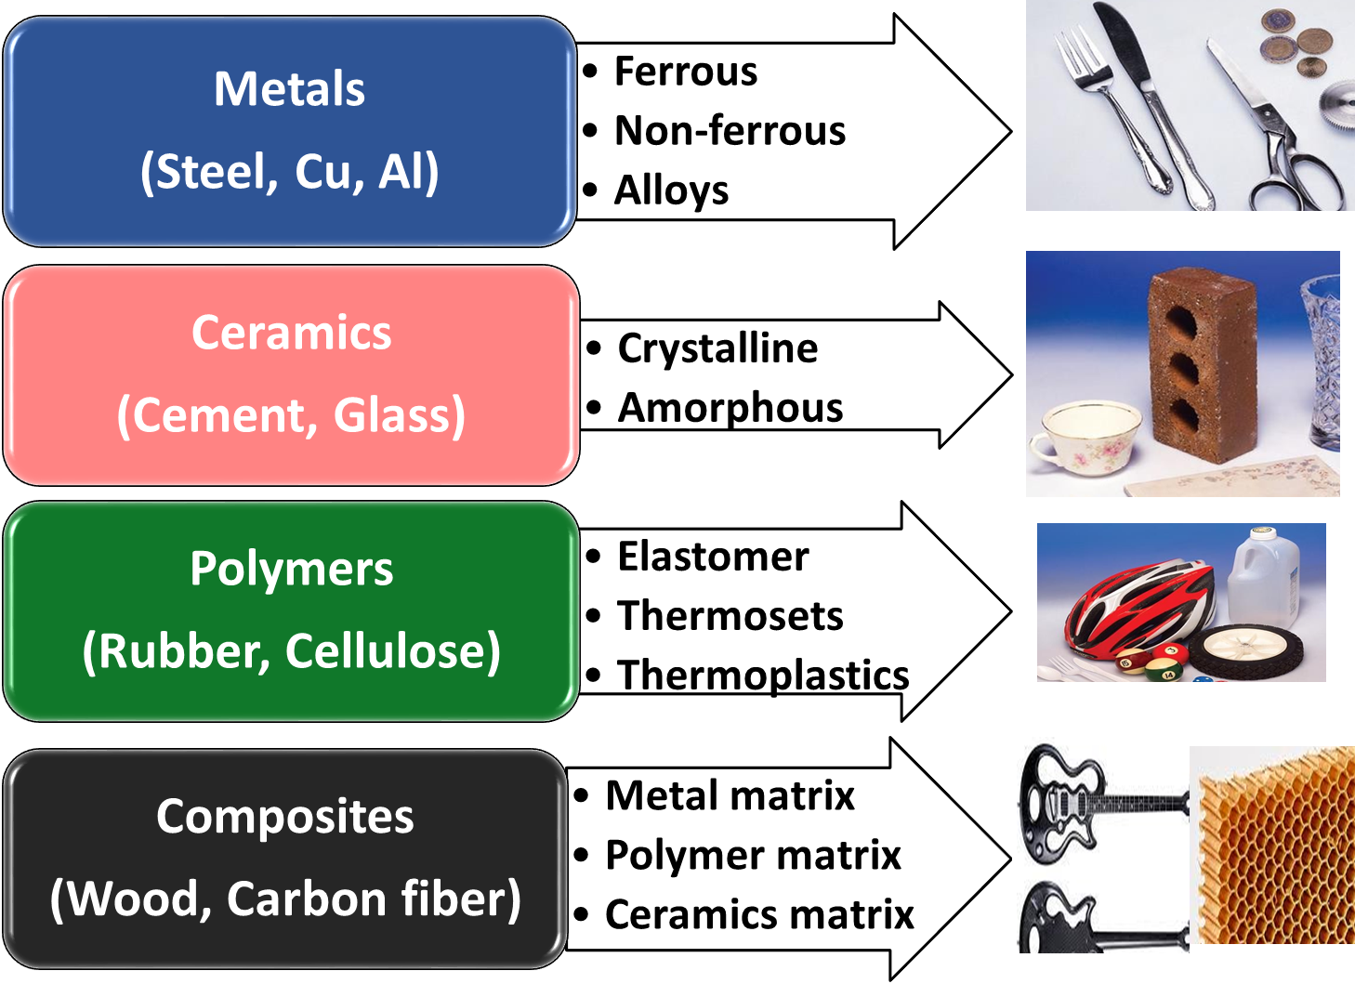
Types of materials based on STRUCTURES

Slide 6

f02_01_pg4
Optical: Transmittance
Polycrystal:
low porosity
Polycrystal:
high porosity
single crystal

Slide 7
f01_01_pg4
What is Materials Science & Engineering?
What does each of these terms mean?
Science: Investigate the relationships
Engineering: Design or engineer the structure of materials that produce a set of pre-determined properties

Slide 8
Why Study Materials Engineering?
Design problem involving materials:
Transmission gear, Oil refinery component, Aero-Engine components, Integrated Circuit chips
Select the right material
- Performance in service condition
- Performance over long run
- Cost
Optimization of the properties
Familiarity with the Processing—Structure--Property relationships and the Processing techniques
→ Proficient and Confident in judicious selection of materials

Slide 9
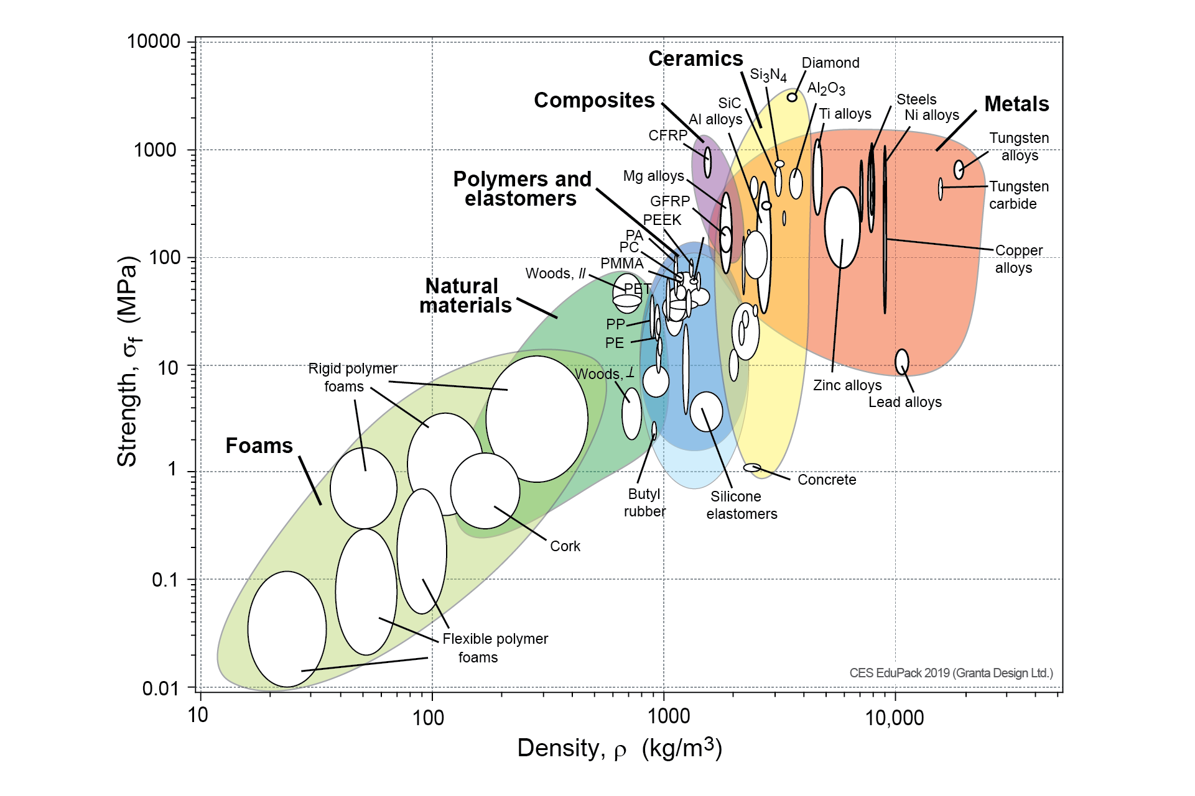
Structure-mechanical property relationships

Slide 10


Structure-dependent interesting mechanical property
Graphene
C
C
C
C
C
C
C
C
C
C
C
C
C
C
C
0.14 nm
Graphene is a hexagonal form of ‘Carbon’, the same element which makes ‘Diamond’ and every living being!
Graphene has a Young’s modulus of 1000 GPa, and a tensile strength of 100 GPa. It is 100× STRONGER than STEEL.
It would take an elephant, standing on a pencil to break through a Graphene sheet!!!!!!!!!!!!!!!!!

Slide 11
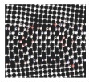
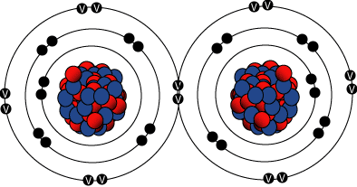
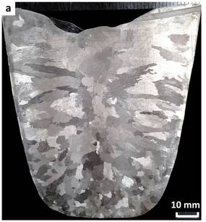
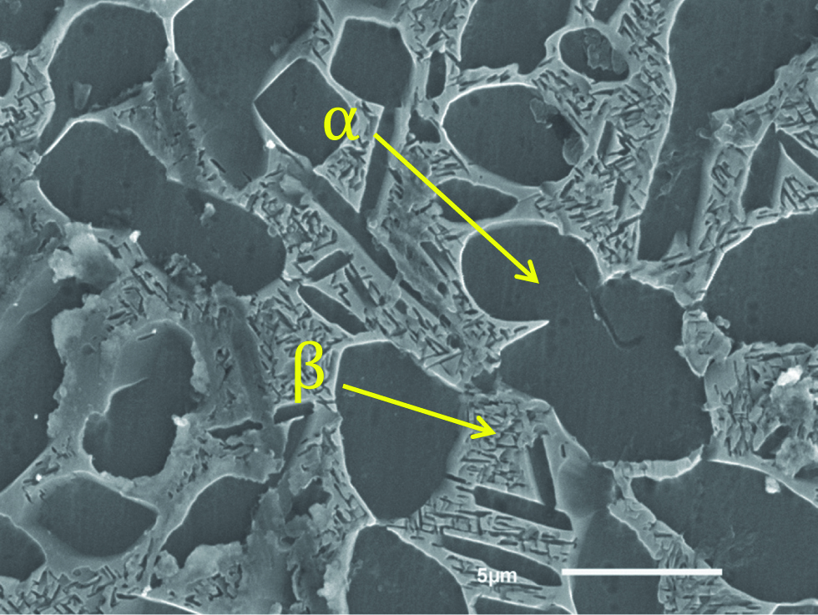
Structure
: Arrangement of material’s internal components
Subatomic:
Atomic
Microstructure
Macrostructure

Slide 12
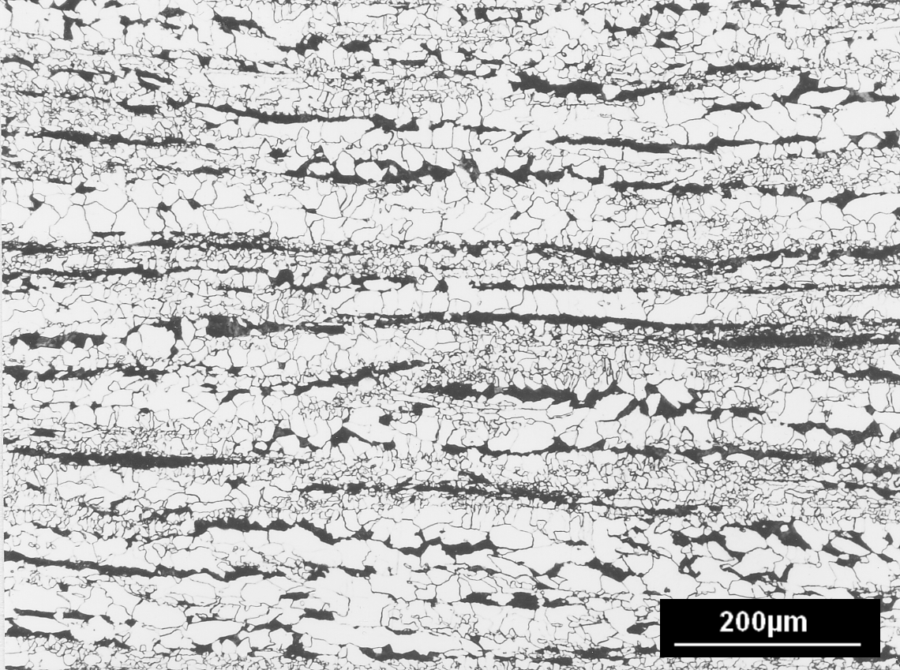

Strength of materials: defining role of microstructure
1 µm= 10⁻⁶ m
Optical microscope

Slide 13
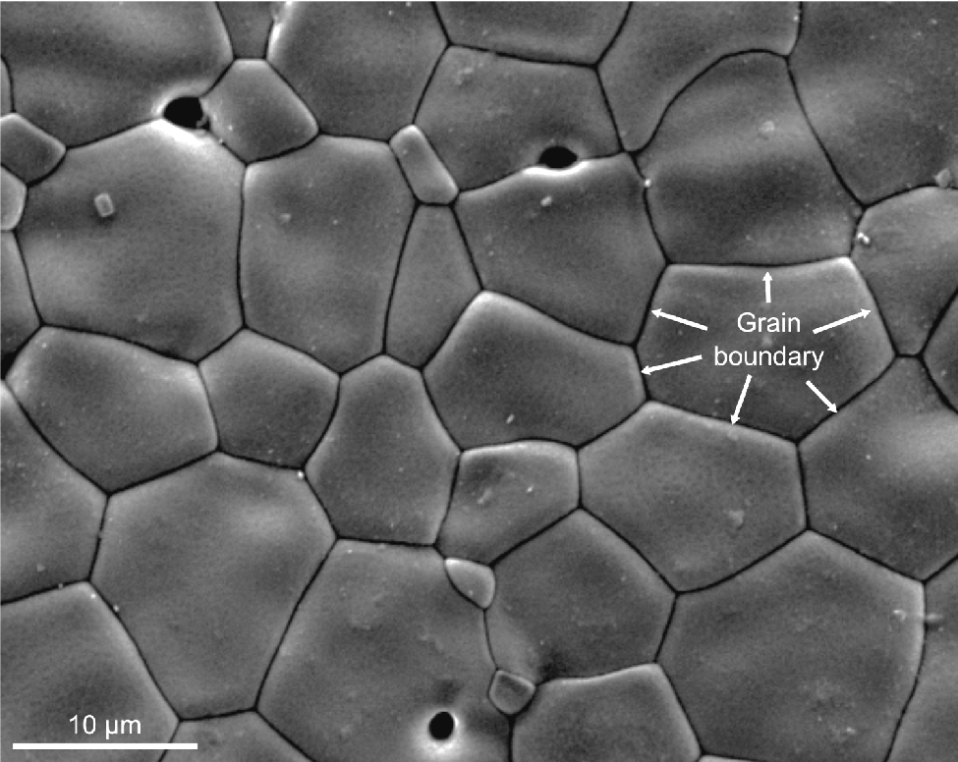
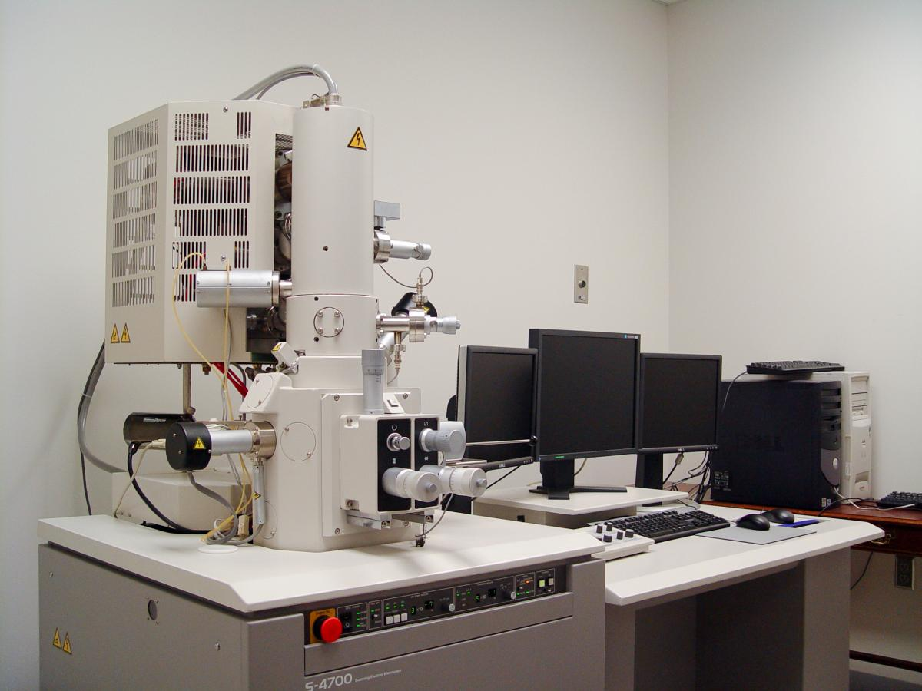
Strength of materials: defining role of microstructure
Scanning Electron Microscope
1 µm= 10⁻⁶ m

Slide 14
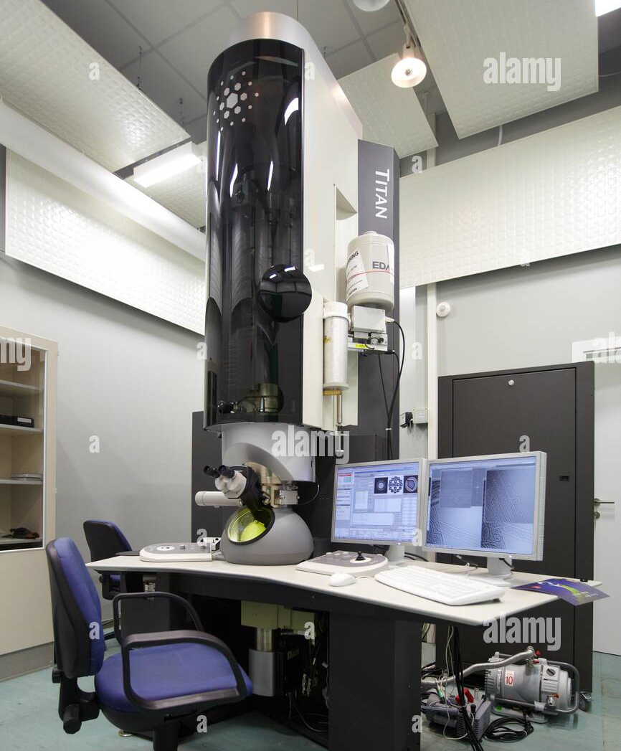
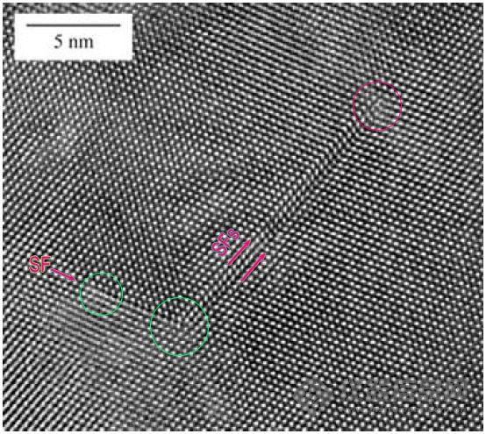
Strength of materials: defining role of microstructure
Individual atoms
High Resolution Transmission Electron Microscope
1 nm= 10⁻⁹ m

Slide 15

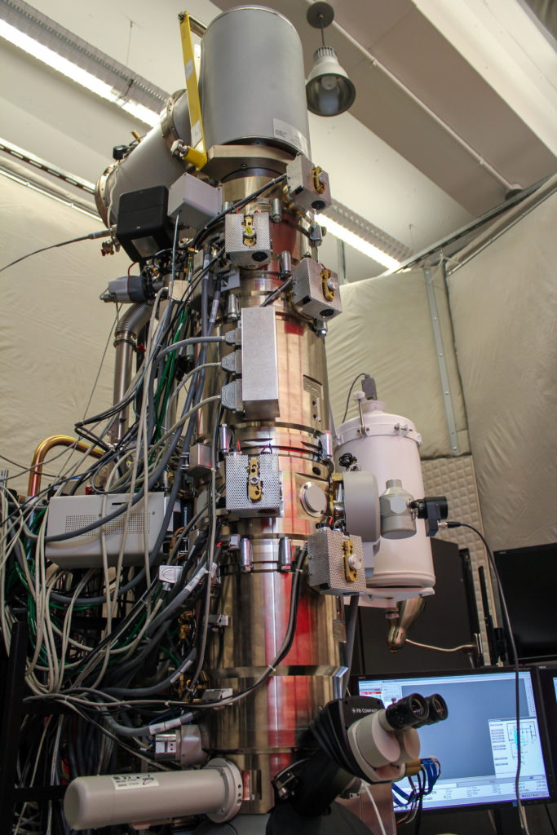
Strength of materials: defining role of microstructure
Video
Individual vibrating atoms
CCMR
Cryo STEM (Cornell)
Science 372.6544 (2021): 826-831

Slide 16
Important Material properties for various applications
Mechanical
Electrochemical
Physical
Corrosion resistance
Oxidation resistance
Hardness
Strength
Modulus
Ductility
Fracture Toughness
Impact toughness
Hardness
Formability
Fatigue resistance
Creep resistance
Melting point
Thermal conductivity
Electrical conductivity
Magnetic properties
Transparency
Sonority
Aesthetics
Surface finish
Paint ability

Slide 17
Important Material properties for various applications
Mechanical
Electrochemical
Physical
Corrosion resistance
Oxidation resistance
Hardness
Strength
Modulus
Ductility
Fracture Toughness
Impact toughness
Hardness
Weldability
Formability
Wear resistance
Fatigue resistance
Creep resistance
Melting point
Thermal conductivity
Electrical conductivity
Magnetic properties
Transparency
Sonority
Aesthetics
Surface finish
Paint ability

Slide 18





Brittle vs Ductile materials and consequences
Titanic movie scene

Slide 19
Today’s specific lab experiment:
Tensile behavior of different engineering Materials

Slide 20
Materials
Testing of ductile material:
Mild steel
Copper
Testing of Brittle material:
Fe-Al alloy

Slide 21
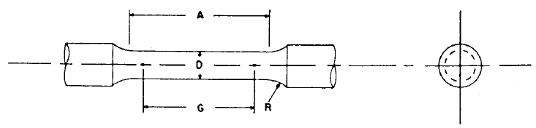
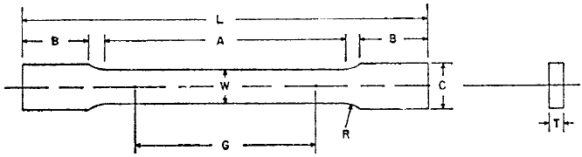
Cylindrical Sample geometry
Mild Steel specimen: Total length= 100 mm, G (l₀) = 25 mm, D = 5 mm
Copper specimen: Total length= 100 mm, G = 25 mm, D = 6 mm
Flat Sample geometry
Fe-Al alloy flat specimen: L = 100 mm, G = 25 mm, W = 6 mm and T = 3 mm.

Slide 22
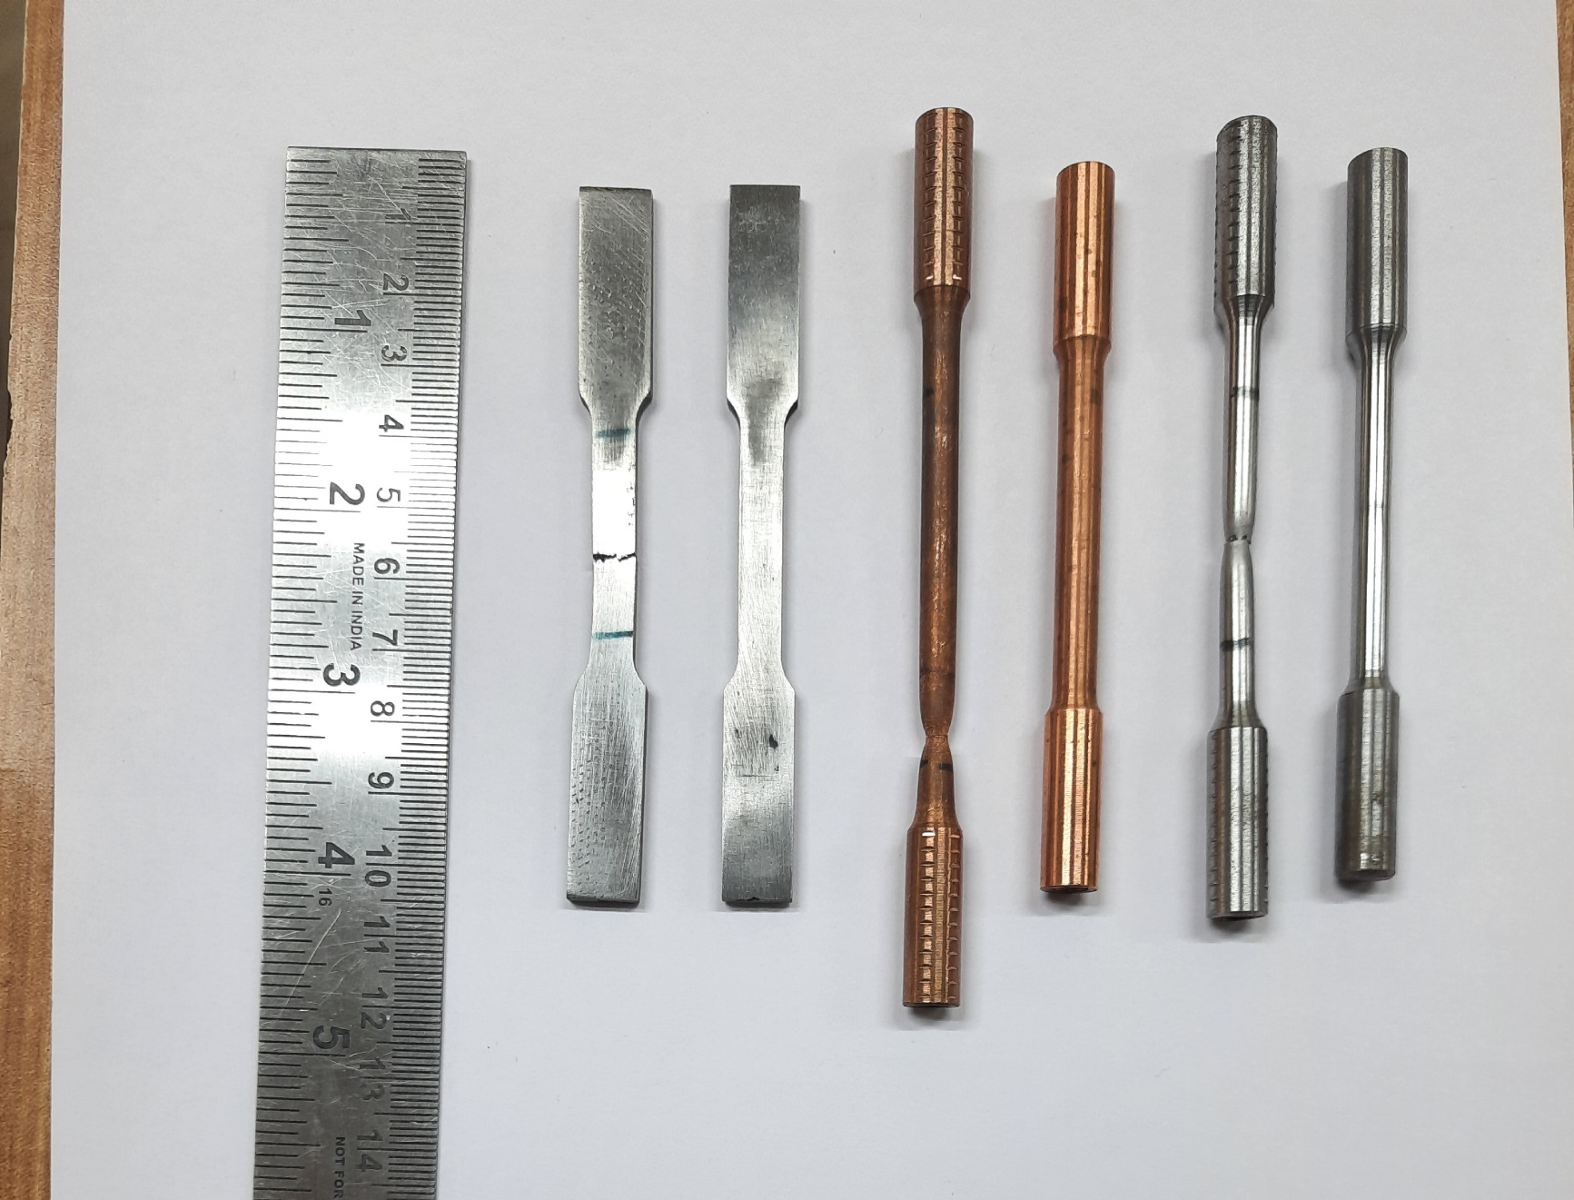
Mild Steel Specimen
Copper Specimen
Fe-Al Specimen (Brittle)

Slide 23
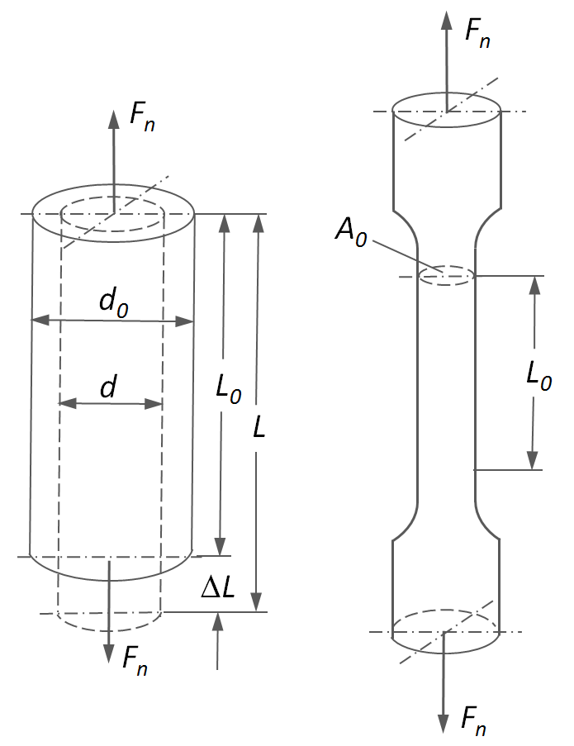
Engineering Stress and Engineering Strain
Or, P
Engineering Strain:
Ratio of change in length (displacement) to the original length.
e = Δl/l₀ = (l – l₀)/l₀
Or, P
Engineering Stress
S = Load/Initial Area = P/A₀
Initial cross section area
Or, P
Or, P
Guage Portion

Slide 24
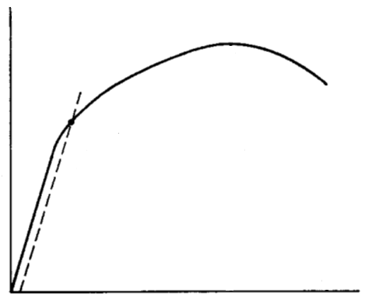
Typical Engineering Stress vs. Engineering Strain curves for a ductile metal
S_{u}
S_{f}
S_{y}
Engineering stress, S
0.2 % strain offset
(e=0.002)
e_{u}
e_{f}
Engineering strain, e
Loading and unloading curves showing the recoverable elastic deformation (b, d) and permanent plastic deformation (a, c).
The engineering stress (S) vs. engineering strain (e) curve for a ductile metal.

Slide 25
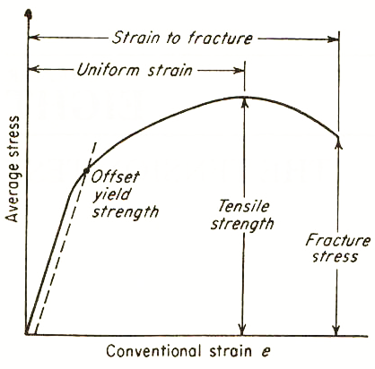
Engineering Stress-Strain Curve
0.2% Offset Yield Strength, S_{o}
Tensile Strength or Ultimate tensile strength, UTS, S_{u}
Uniform Strain, e_{u}
Strain to Fracture, e_{f}
Elastic limit

Slide 26
Some important points on the Stress – Strain curve
Elastic Limit: The point up to which material shows elastic behaviour, i.e., displacement becomes zero as the load is removed. Immediately after elastic limit permanent plastic deformation starts. Elastic limit, however, is extremely difficult to detect as the amount of permanent deformation just after that point is very very small. Therefore, elastic limit is not determined for engineering application.

Slide 27
Some important points on the Stress – Strain curve
Yield Strength: Point at which small but detectable, or measurable, amount of plastic deformation happens. If yield point phenomenon takes place (like in mild steel specimen) then it becomes easy to identify yield point. If the stress-strain curve is continuous without yield point phenomenon then either 0.1% or 0.2% strain offset method is adopted to locate the yield point (as shown in a schematic above). Stress corresponding to the yield point is yield stress. For structural applications we never want that applied stress exceeds yield strength of the metal as the structure can deform permanently. In contrast, for manufacturing of metal, plastic deformation is required and applied stress has to be higher than the yield strength.

Slide 28
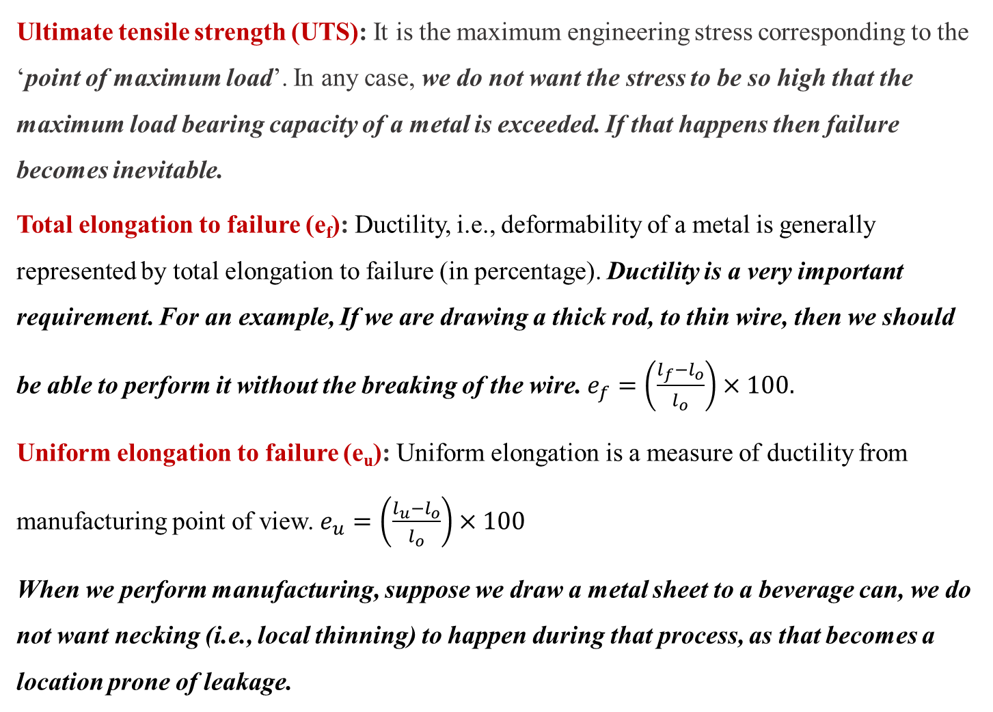
Ultimate tensile strength (UTS): It is the maximum engineering stress corresponding to the ‘point of maximum load’. In any case, we do not want the stress to be so high that the maximum load bearing capacity of a metal is exceeded. If that happens then failure becomes inevitable.
Total elongation to failure (e_{f}): Ductility, i.e., deformability of a metal is generally represented by total elongation to failure (in percentage). Ductility is a very important requirement. For an example, If we are drawing a thick rod, to thin wire, then we should be able to perform it without the breaking of the wire. $e_{f}=\left(\frac{l_{f}−l_{o}}{l_{o}}\right)×100.$
Uniform elongation to failure (e_{u}): Uniform elongation is a measure of ductility from manufacturing point of view. $e_{u}=\left(\frac{l_{u}−l_{o}}{l_{o}}\right)×100$
When we perform manufacturing, suppose we draw a metal sheet to a beverage can, we do not want necking (i.e., local thinning) to happen during that process, as that becomes a location prone of leakage.

Slide 29
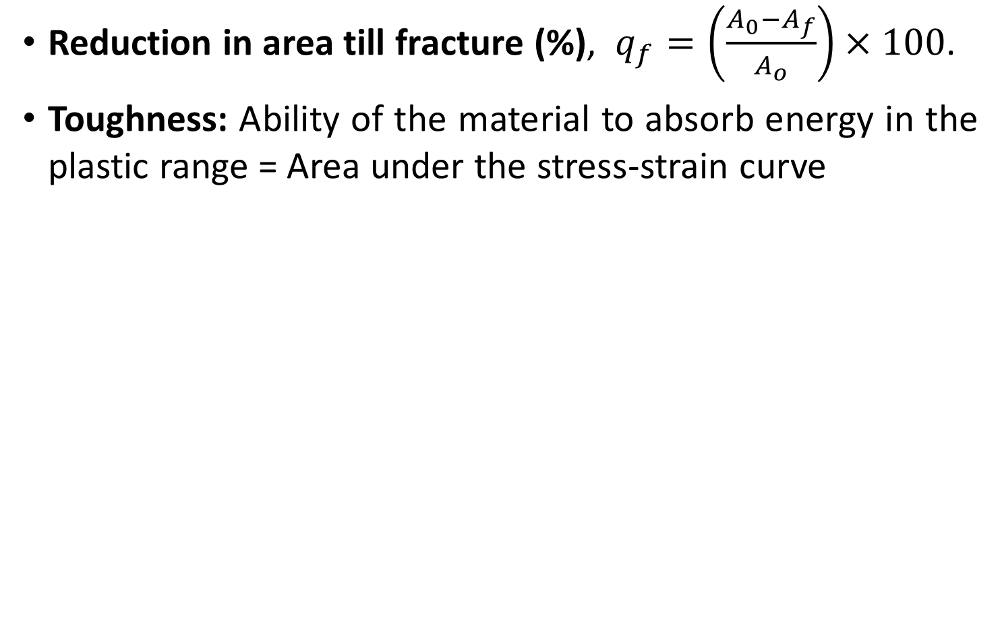
Important Terminologies
Reduction in area till fracture (%), $q_{f}=\left(\frac{A_{0}−A_{f}}{A_{o}}\right)×100$.
Toughness: Ability of the material to absorb energy in the plastic range = Area under the stress-strain curve

Slide 30
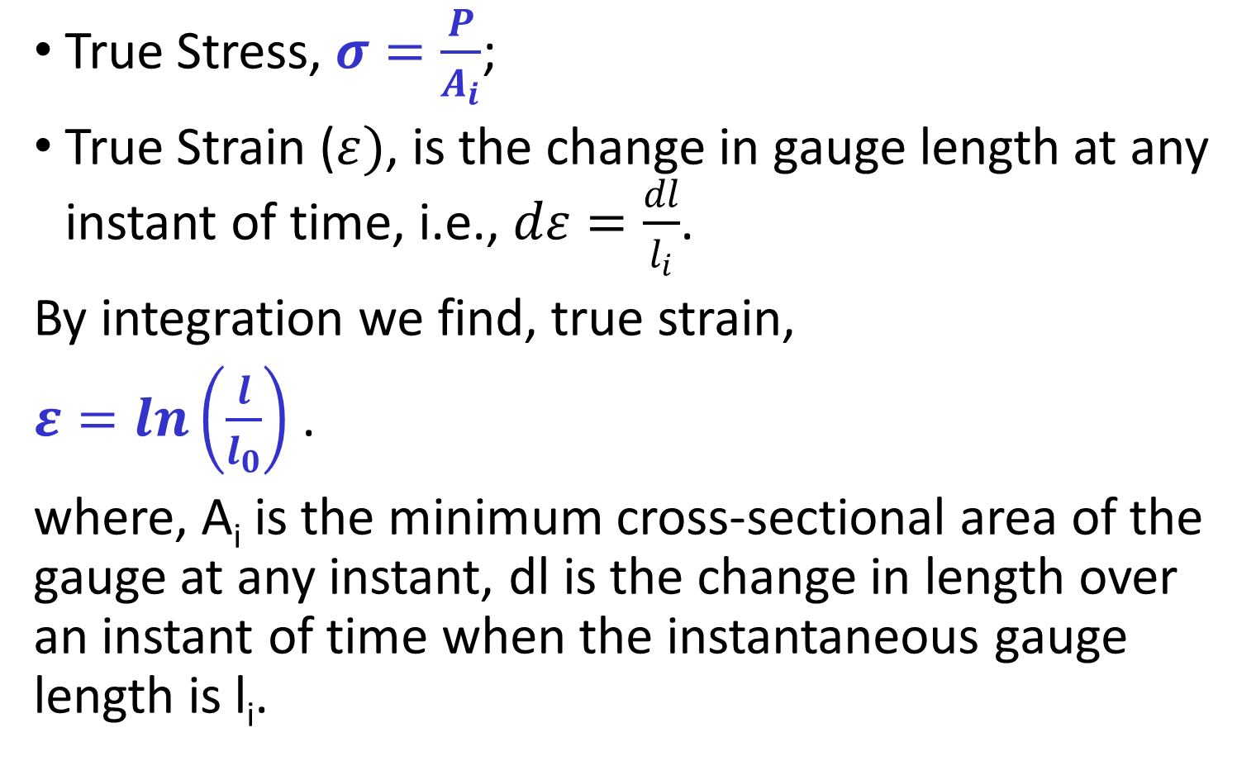
True Stress and True Strain
True Stress, $σ=\frac{P}{A_{i}}$;
True Strain ($ε)$, is the change in gauge length at any instant of time, i.e., $dε=\frac{dl}{l_{i}}$.
By integration we find, true strain,
$ε=\ln\left(\frac{l}{l_{0}}\right)$ .
where, A_{i} is the minimum cross-sectional area of the gauge at any instant, dl is the change in length over an instant of time when the instantaneous gauge length is l_{i}.

Slide 31
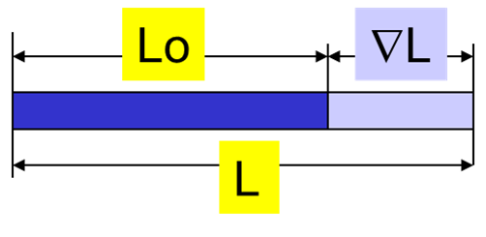
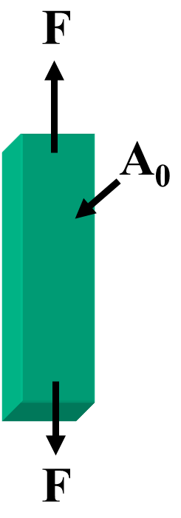
Relation between stress and strain
During plastic deformation, volume remains constant.
l₀
Δ l
l₀×A₀ = l×A
⇒ A₀/A = L/L₀
Engineering strain, e = (l-l₀)/l₀ = l/l₀ – 1
⇒ l/l₀ = 1+ e
⇒ A₀/A = 1+ e
True Stress (σ) = P/A = (P/A₀).(A₀/A) = S(1+e)
σ = S(1+e), is valid up to necking
l
P
A₀
P

Slide 32
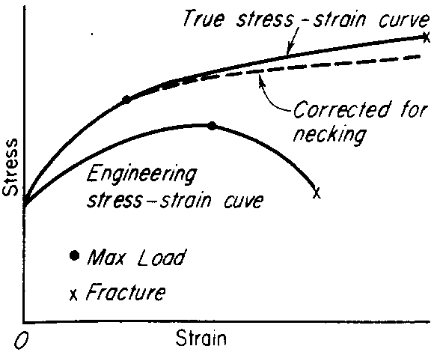
Comparison between engineering stress-strain and true stress-strain curves. (Elastic deformation is very small, and hence, ignored)
Why such a difference?
Follow the next slides

Slide 33
Question: Why true stress – true strain curve is different from the engineering stress -strain curve?
Answer: A point on true stress - true strain curve lies above and at the left of engineering stress- engineering strain curve. The equations defining true stress, true strain, engineering stress, and engineering strain (as given above) can be referred to understand this aspect. For plastic deformation to happen, stress has to increase continuously to increase the plastic strain and that phenomenon is called ‘strain hardening’. Therefore, true stress inside the specimen increases continuously with the increase in strain at the deforming part of the specimen. However, after a certain amount of uniform deformation, necking happens and the further deformation occurs only within the necked region. The cross-sectional area of the necked region decreases rapidly. As a result, to maintain the increase in true stress, load requirement can decrease. It is to be noted that true stress is the ratio of load and instantaneous cross-section area, which decreases rapidly due to necking. Thus, beyond the point of maximum load (i.e., the UTS point), the engineering stress decreases as it is defined as load divided by a constant (initial cross-sectional area of the specimen). However, after the point of maximum load, a correction needs to be incorporated even in true stress – true strain curve as the specimen shape changes due to necking.

Slide 34
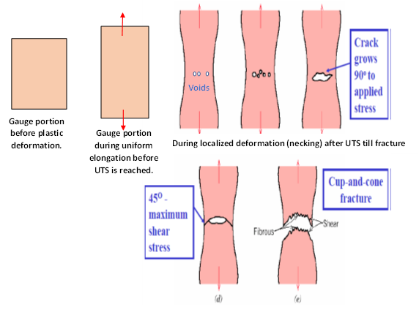
Question: How a tensile test specimen of ductile material looks like during different stages of plastic deformation?

Slide 35
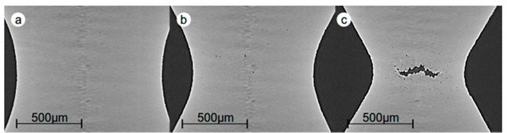
Necking accompanied by Void and crack formation
Zig-Zag path

Slide 36
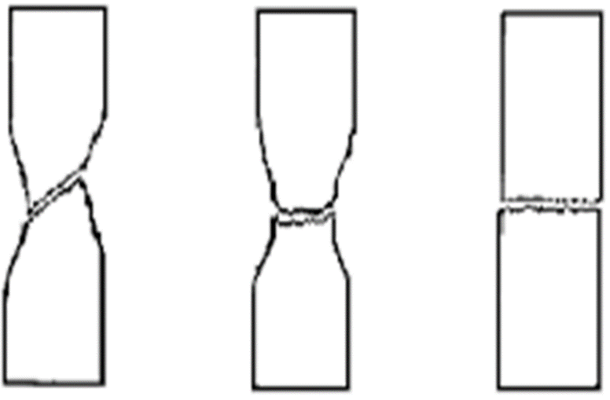
Question: How to distinguish between a ductile material and a brittle material just by seeing the fractured specimens?
Answer: Ductile material typically undergoes either through ductile rupture or cup-and-cone fracture with dull appearance on fracture surface. In contrast, a brittle material typically shows flat-fracture surface with shiny appearance.
Ductile rupture
Cup and Cone ductile fracture
Flat fracture in brittle material

Slide 37
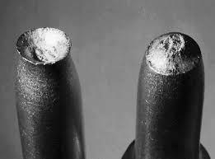
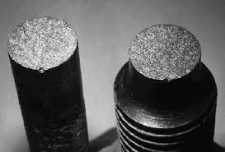
Distinct features in fracture surfaces
Cup and Cone Ductile Fracture
Metallic Alloys
Flat and Shiny Brittle Fracture

Slide 38
Thank You

